Slide 1
860个玉米灯客户案例分享

Slide 2
:
5-15 询盘回复
5-25 要求免费样品
6-20 样品单确认完成付款
3pcs pizza + 3pcs corn light $751
10-02 第二次样品单完成付款 5pcs 100w retrofit kit $505
12-07 第三次单完成付款
860pcs 150w corn light $63,227

Slide 3
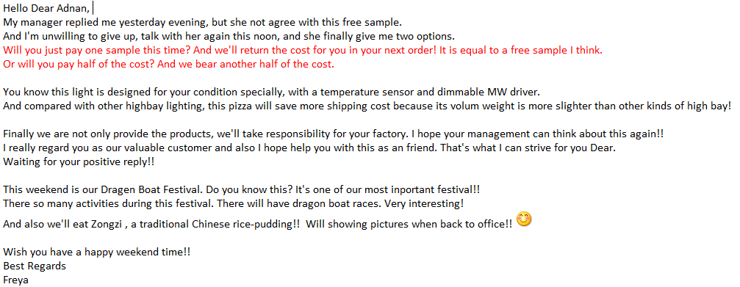

Slide 5
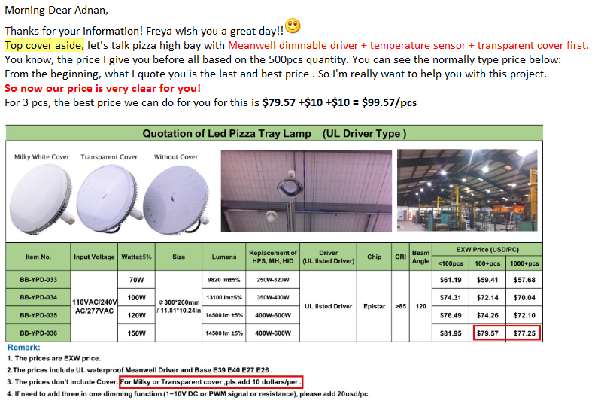

Slide 6
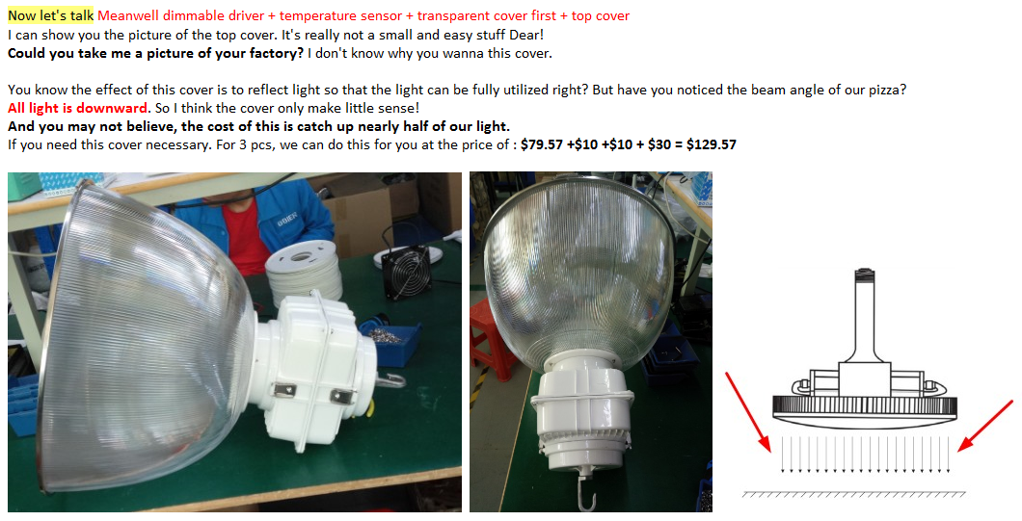

Slide 7
客户要求降价，怎么做
一. 降价的原因
是真的有订单需求还是只是在比价，降价一定能拿到订单吗？首先要明确是不是降价客户就一定会下单，然后再考虑降多少的问题，降之前可以问的问题。如果有回复，那就可以考虑降价的问题
a. 需要的数量
b. 大概的交货时间
c. 下单时间
d. 有什么特殊的需求
二. 降价的时机
a. 不要轻易亮出底牌
b. 不要降幅太大
c. 争取下单时间
三. 降价的方式
a. 首次降价不能降得太多
b. 梯度降价，降价幅度依次递减
这样降价的目的是让客户明白你没有很多利润可以赚，而且之前也没有开高价给他

Slide 8
降价的技巧：
1. 不要把价格说得太死，要灵活，有弹性。
2. 价格让步也要有技巧,不要轻易让步，不要对客户言听计从
3. 对于客户说的价格要判断是否属实？让客户发产品信息，我们可以列出差别之处让客户清楚贵在哪。
4. 要让客户觉得你在帮他而不是坑他。可以回复说找财务核算一下成本。
降价的过程中其实也是一个沟通谈判的过程，价格只是其中一个因素，这期间有很多的因素会影响最终的结果，例如谈判技巧，对客户的了解程度，还有你做事的风格等等。

Slide 9
1. After carefully calculating the price, we decide to make a further concession of $2/pc. In the hope that this would lead to an increase in business between us.
2. Taking our friendly business relations into consideration, we would exceptionally comply with your request by reducing our prices to $2/piece. However, this should not be taken as a precedent in future.
3. We have noted your request for a reduction of 8% on our price, but regret to say that there is no space for a reduction as we have quoted you our lowest price. Any further lower will kill us :(
4. In China domestic market, all costs are increasing, labor costs, raw material, electricity/water costs etc.. The real cost of our product is increasing, not decreasing. We are facing pressures from both sides. Hope you can understand.
5. As you mentioned that our price is a little high and not competitive. Could you please tell me which supplier's products you are comparing with?
6. We've already cut down our prices to cost level.
7. I appreciate your counteroffer but that really too low to accept.
8. This is our final offer in order to keep good quality. Of course we can do lower price, but then we cannot garrantee the quality. We would rather keep good quality for you and hoping you will come back for more. Not selling you cheap things and you never come back to us. Please do understand that is our motto for business.

Slide 10
Thanks

